Slide 1
Introduction to CCSA Standardization Activities
Bingmei Wu
August 15, 2017

Slide 2
Establishment and Membership
Founded in 2002, CCSA serves as a platform for the formulation of national standards and industry standards in China’s ICT sector and also as a trial reform of the Govt. on standardization.
Membership
  400 CCSA members account for more than 95% of the industry output value in China, making CCSA a critical platform for stakeholders in the ICT industry chain to participate in standardization activities.
  Multinational
Mission
  Cooperation with many international SDOs makes CCSA an important SDO in Global ICT standardization Eco.
  CCSA contributes greatly to the efficient and safe operation and also the sound and healthy development of China’s ICT industry.
  CCSA standardization aims to meet the demands of national strategy, government regulation and social livelihood.

Slide 3
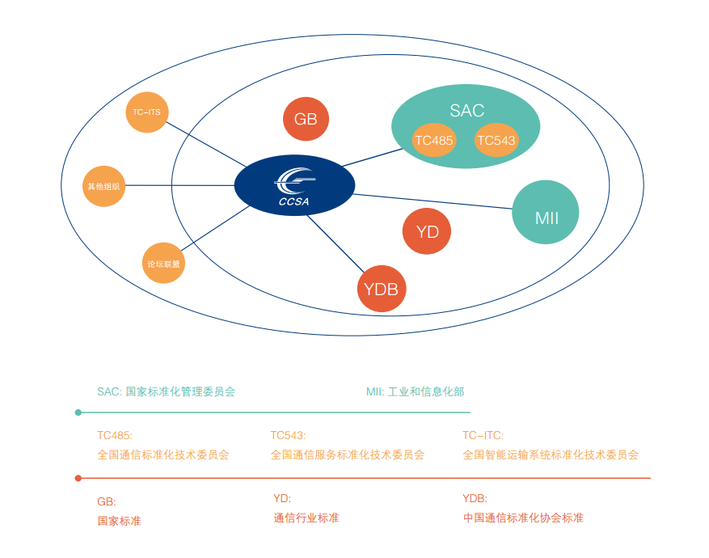
Robust Standardization Ecosystem
Inter-government
organizations
ITU
ISO
IEC
Inter-government
organizations
Industry organizations
CCSA
ETSI
3GPP
GSC
ARIB
TSDSI
… …
TTC
ATIS
CJK
TTA
TIA
SAC: Standardization Administration of CPC
MIIT: Ministry of Industry and Information Technology
TC485: National Technical Committee 485 on Communication of SAC
TC543: National Technical Committee 485 on Communication Service of SAC
TC-ITS: National Technical Committee 485 on Intelligent Transport Systems of SAC
GB: National standard
YD: ICT industry standard
YDB: CCSA standard
oneM2M
oneM2M
IEEE
IETF
OMA
… …
Cooperation platform
for standards
OP
Cooperation platform
for standards
Specialized international SDOs
SDOs

Slide 4
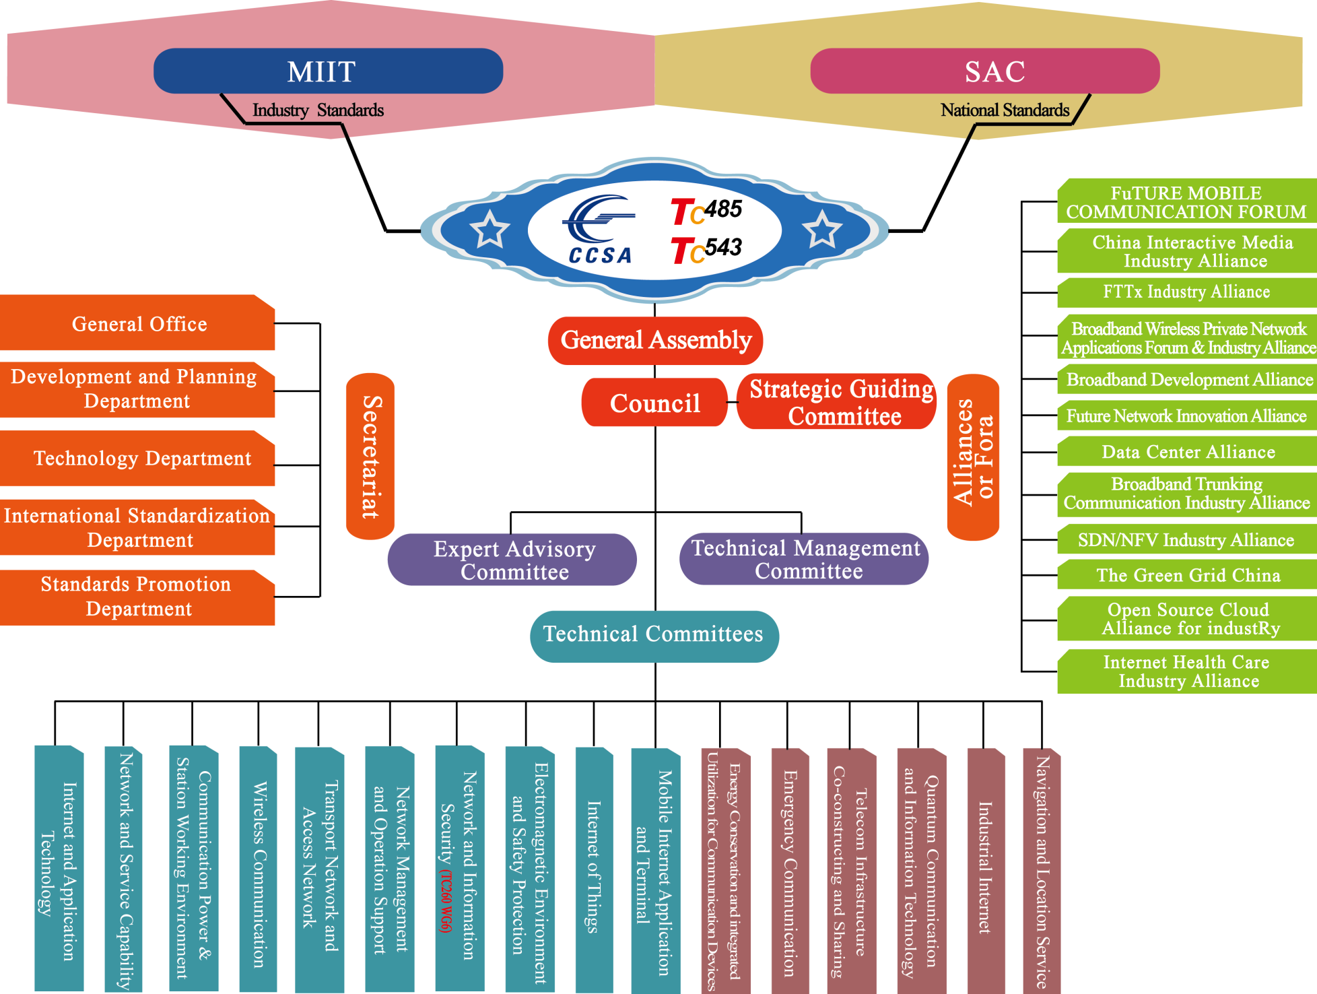
Organizational Structure

Slide 5
Main Tasks in 2017
Technology
5G
IoT/M2M
Cloud computing
Optical networks
Internet +
Quantum communications
AI/VR/AR
Big data
SDN/NFV
Future networks
Industrial internet
IoV/Car networking
Security
In 2017, CCSA keeps formulating standards on key technical fields in the ICT industry such as 5G, and also cooperate with vertical industries and formulate standards on enabling technologies.

Slide 6
What are business priorities in vertical industries today & tomorrow?
Top X Business？
Smart Home
Smart manufacturing
Flexible manufacturing
Customization
Intelligent car
Autonomous driving
ADAS
Auto electronics
Smart Sustainable city
IoT/M2M
After-sales services
Internet+ Energy/Agriculture
Sales
For ICT industry:
What opportunities?
For SDOs:
What to do?
? Net/Connections
Cloud /Edge Computing
Big data/AI
Standards
Cooperative Stds
Harmonized Stds
Enabling Stds for Vertical industries
Or something else more importent？

Slide 7
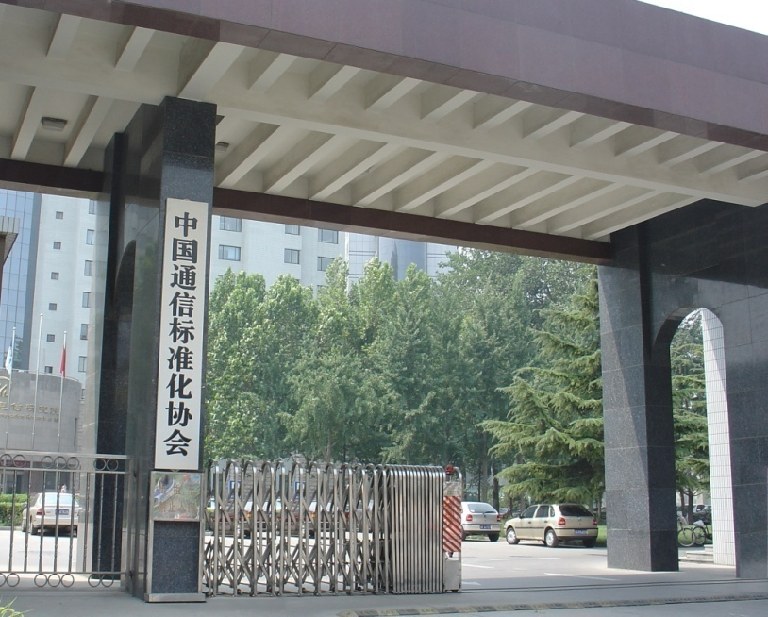
Thank you!
52# HuaYuanBei Road, Haidian District, Beijing China, 100191
Website:
www.ccsa.org.cn
Tel.: +86-10-62302734
Fax: +86-10-62301849
China Communications Standards Association

