Slide 1
Study on
Digital Switchover Plan in SATRC Countries
2nd SATRC Spectrum WG Meeting
11-12 March, 2014
Tehran, I.R.Iran
    Rumana Haque
      Bangladesh Telecommunication Regulatory Commission

Slide 2
Introduction
Digital switch over – the transition from analogue to digital TV and digital radio – presents an important opportunity for spectrum regulators to review the overall use of the spectrum.
Digital broadcasting offers the opportunity to create more television and radio programmes more efficiently using less spectrum.
GE06 established frequency plans for analogue and digital broadcasting in Band III (174–230MHz) and Band IV/V (470–862MHz). ITU declared 17 June 2015 as the end of the transition period for the phasing out analogue television in GE06.

Slide 3
Why DSO is necessary
It is important because harmonization of frequency assignments maximize value of digital dividend globally and supply of equipment will become a problem in near future as the analogue transmitter manufacturer is already being stopped their production.
It is necessary to consider the co-operation among the countries in this region in terms of selecting the standard, frequency co-ordination etc to expedite the digital switchover process. All countries except Maldives and Sri Lanka have the land borders. So co-ordination is required for smooth transition that tends to provide interference free services.

Slide 4
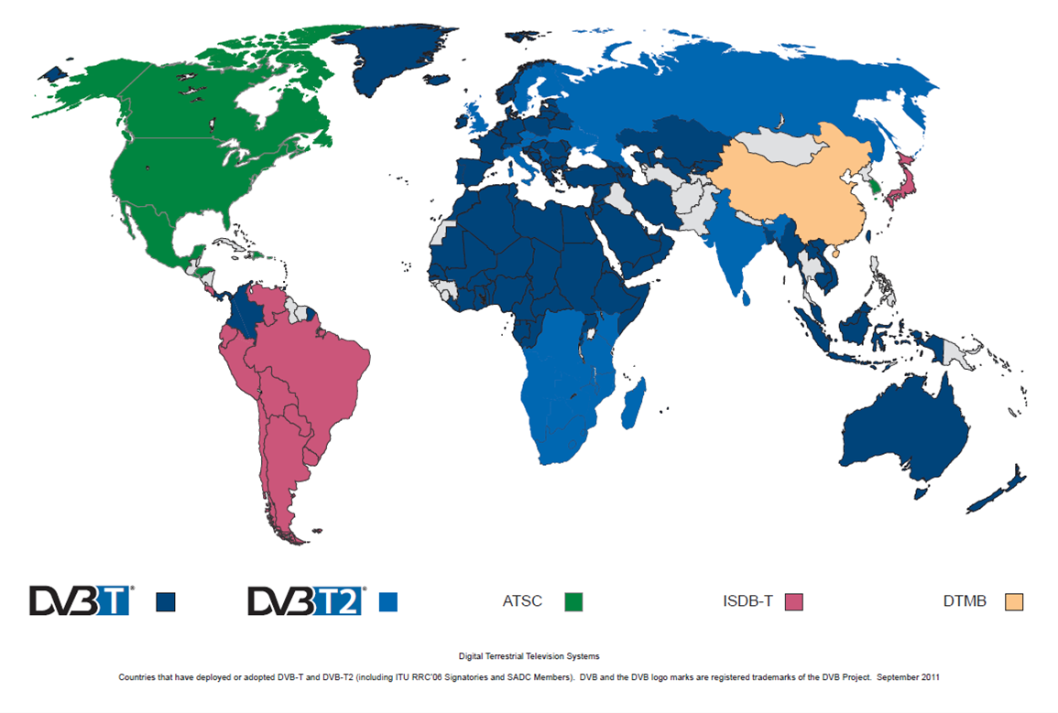
Global Trend
ISDB (T)– Integrated Services Digital Broadcasting (International) DVB - Digital Video Broadcasting
DTMB – Digital Terrestrial Multimedia Broadcast ATSC – Advanced TV System Committee

Slide 5
DSO standards in SATRC countries
There are 6 out of 9 countries namely Iran, India, Nepal, Bhutan, Bangladesh and Afghanistan have adopted DVB-T/T2 standard.
Maldives and Sri Lanka have considered for ISDB standard while Pakistan yet to decide the standard as well as not to take any decision to move forward into the switchover process.

Slide 6
Status of DSO in SATRC countries
India is cleanly ahead in this region to mark the television broadcasting system from analogue to digital in DVB-T2 standard.
Digitization, on cable and terrestrial, have four phases, in a 3-year transition started from 31 October 2012, and finishing on 31 March 2015.
The four metros of Delhi, Mumbai, Kolkata and Chennai have shifted to digital addressability by 31 October 2012.
The second phase includes 35 cities with a population of more than one million, such as Patna, Chandigarh, Pune and Bangalore by 31 March 2013.
All urban areas are expected to digitize by 30 November 2014 and the remaining areas by 31 March 2015. They have executed these phases in almost given time line as per the plan.

Slide 7
Status of DSO in SATRC countries (contd..)
In Iran, already DTTB is introduced to almost all the cities in DVB-T standard.
Islamic Republic of Iran Broadcasting is responsible to implement DTTB throughout the country.
Only the Government owned television channel can broadcast the terrestrial and it would be switchover to digital terrestrial broadcasting.

Slide 8
Status of DSO in SATRC countries (contd..)
Afghanistan has selected DVB-T2 standard for implementing the analogue to digital transformation in the country.
The digital transformation implementation has been commenced in Kabul on 01 March, 2015.
Ministry of Communications and Information Technology plans to make the entire country digital within next 3 years.

Slide 9
Status of DSO in SATRC countries (contd..)
In Nepal, the ASO committee was formed by the official from different organizations.
The committee prepared National Government Broadcaster and common DTTB Platform for broadcasting operators in private sector.
The committee has set the complete digitization date that can be achieved by Dec 2017.
The standard is DVB-T.

Slide 10
Status of DSO in SATRC countries (contd..)
Bangladesh has adopted DVB-T2 standard for DTTB.
In the National Frequency Allocation Plan (NFAP), the band 522-698 MHz is reserved for digital DTTB.
At present, Bangladesh Television (BTV), a government owned organization has the sole right by Act to broadcast terrestrial transmission in VHF Band-III in 174-230 MHz band. It is already broadcasting digital terrestrial system in VHF Band III through three stations on test basis.
The UHF band is still empty which is reserved for this purpose.
The national roadmap suggests the migration from analogue to digital broadcasting within 2020 in DVB-T2 standard in 522-698 MHz.

Slide 11
Status of DSO in SATRC countries (contd..)
Bhutan plans for mobilizing resources and a trial run as per their road map on DTTB migration. This is to be completed by 2014.
They have selected DVB-T standard.
This process is to be completed by December 2016.
Bhutan has marked its ASO date on 2017 (tentatively).

Slide 12
Status of DSO in SATRC countries (contd..)
Maldives Broadcasting Commission has started to formulate a road map for the migration of terrestrial broadcasting services from analogue to digital technology.
They have decided to adopt ISDB-T standard.
The ASO date is yet to be decided.

Slide 13
Status of DSO in SATRC countries (contd..)
Sri Lanka has taken decision on the introduction of digital television transmission on ISDB-T standard.
They have set their plan for implementing the ISDB-T as follows:
-Complete ASO by end 2018 (tentatively).
-Deployment of One Seg for Digital Mobile Television Broadcasting has been planned.

Slide 14
Status of DSO in SATRC countries (contd..)
Pakistan has not acquired technical standards.
The country is still undecided about the entire switchover process though Pakistan Electronic Media Regulatory Authority (PEMRA) stated in its 2010 annual report it would be completed by 2015.

Slide 15
Regulatory issues
The implementing body of DSO is not the Telecommunication Regulatory Authority but the broadcasting authority or ministry of that respective country. For this, it is difficult to ensure the date of ASO and sometime to fix the standard even.
The planning of the frequency bands in National Frequency Allocation Table as per the Radio Regulation is necessary. And to meet the timeline declared by ITU is also an issue.
Some of the SATRC countries need to amend the law of restricting terrestrial broadcasting from private broadcasters in order to minimize the cost of the switchover and to make it successful to the viewers.
The regulators need to identify procedure of spectrum assignment or awarding license.
It is the time for Regulators to start planning about the digital radio broadcasting.

Slide 16
Thank you
rumana@btrc.gov.bd

